Slide 1
Red Wine Quality
Analysis
Multivariate Data Analysis
Prof. David Belanger
Shreyas Sawant
Siddhesh Powar
Neel Nath

Slide 2
Contents
Overview
Project Summary
Data Understanding
Data Quality Check & Cleaning
Correlation Matrix
Classification
Plot and Plot analysis of factors
Linear Discriminant Analysis
Naïve Bayes
Random Forest
Conclusion
References

Slide 3
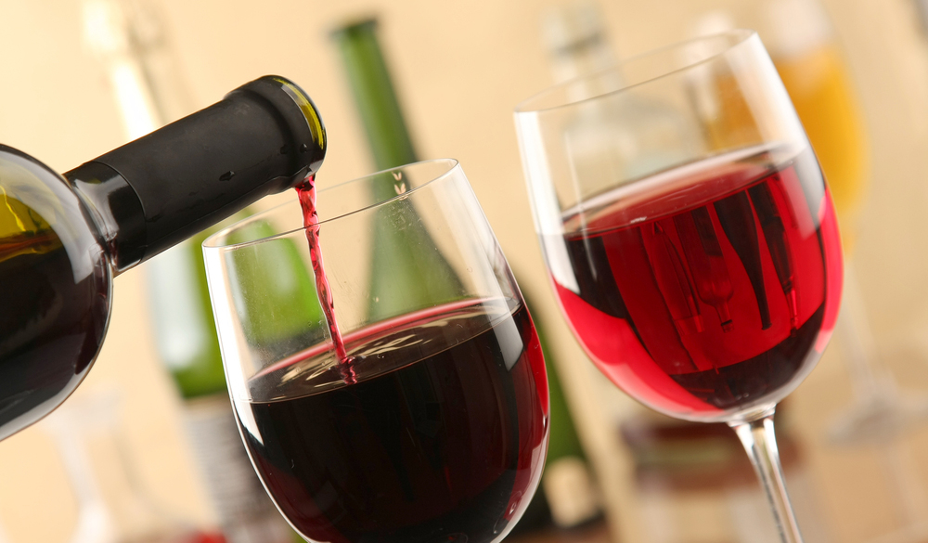
Overview
Analyze the quality of the wine.
The overall scope of this analysis is to comprehend the relationship of various parameters that impact the quality ratings for the wine.
In this analysis we are trying to understand and perform the following:
Determining the factors responsible for the change in the quality of the wine.
Correlation of all the factors.
Creating, training and testing different classification models which can predict the quality of the wine if a new dataset is added based on our current dataset.

Slide 4
Project Summary
Data Source:
The dataset contains information of the factors which determine the quality of the Red Wine.
Dataset available on Kaggle.com
Project Objective:
The objective of this project is to determine how the quality of the red wine gets affected by the different parameters.
Finding correlation between different parameters which affect the wine quality.
Classification of our dataset to categorize the quality of wine between good, average and bad.
Building, training, testing and comparing different classification models to better predict the quality of the wine.

Slide 5
Data understanding
The dataset has 1599 observations and 12 variables.
Quality is the Dependent variable.
All other 11 variables are independent variables based on which wine quality is tested.
Following is a list of variables in the dataset:
Variables Numbers | Variable Type / Description | Variable names
1-3 | Red wine acid composition and concentration | fixed_acidity, volatile_acidity and citric_acid
4-10 | Other components of Red Wine. | residual_sugar, chlorides, free_sulfur_dioxide, total_sulfur_dioxide, density, pH and sulphates.
11 | The alcohol content of the red wine | alcohol
12 | Quality of the wine | quality

Slide 6
Data Quality Check and Cleaning
Data Cleaning
We removed the null values in the dataset.
Tried locating the inaccurate data or an outlier.
Removed the redundancies and considered only the unique rows.
Data Splitting
We randomly split the dataset into training and testing datasets.
Training dataset contains 1120 observations(70%)
Testing dataset contains 479 observations(30%)

Slide 7
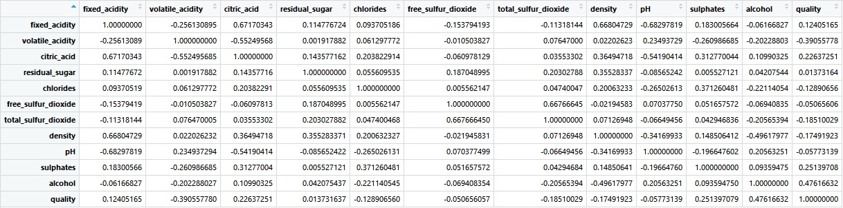
Correlation Matrix
This is the correlation matrix for the factors of the dataset.
Certain factors such as density and fixed acidity were strongly correlated while few others were not.

Slide 8
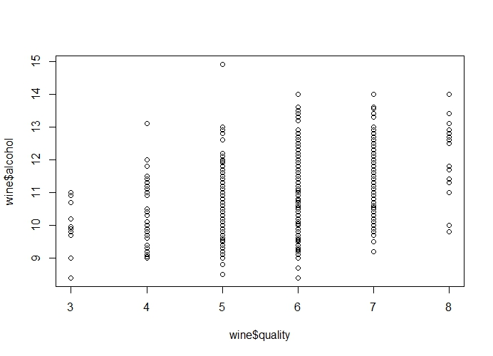
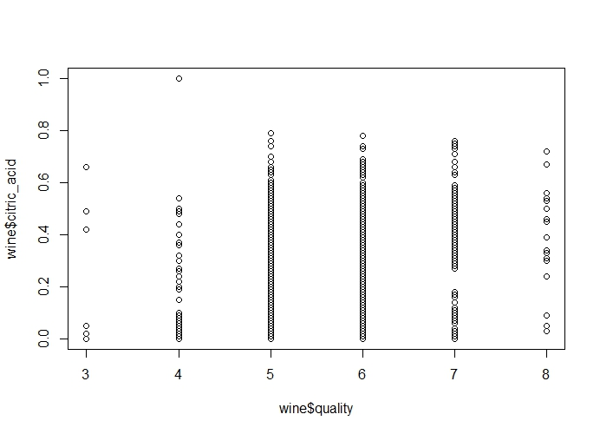
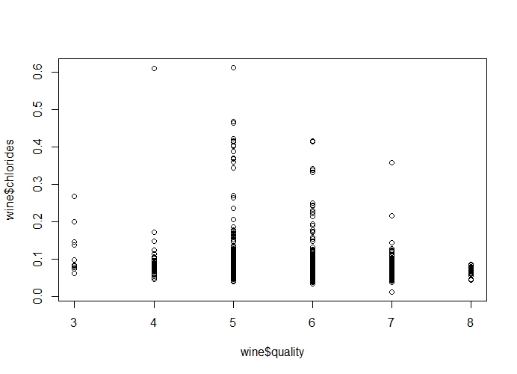
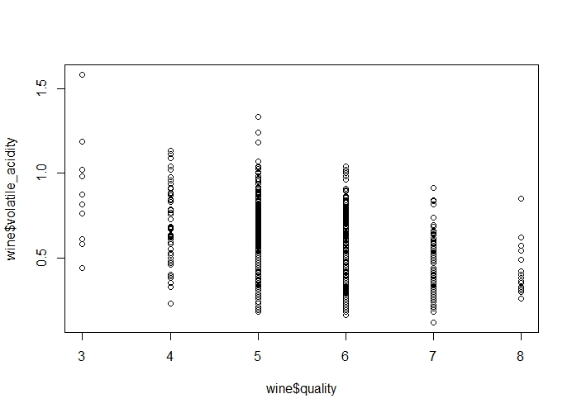
Directly Proportional
Alcohol
Citric Acid
Inversely Proportional
Chlorides
Volatile Acidity

Slide 9
Plot Analysis (OBSERVATIONS)
Comparison of Fixed Acidity, Residual Sugar and Free Sulphur Oxide with Quality did not give us any clear view.
Volatile Acidity and Chloride levels depreciate as Quality increases.
Alcohol and Citric Acid show an Upwards trend (Directly proportional) when compared to the quality.

Slide 10
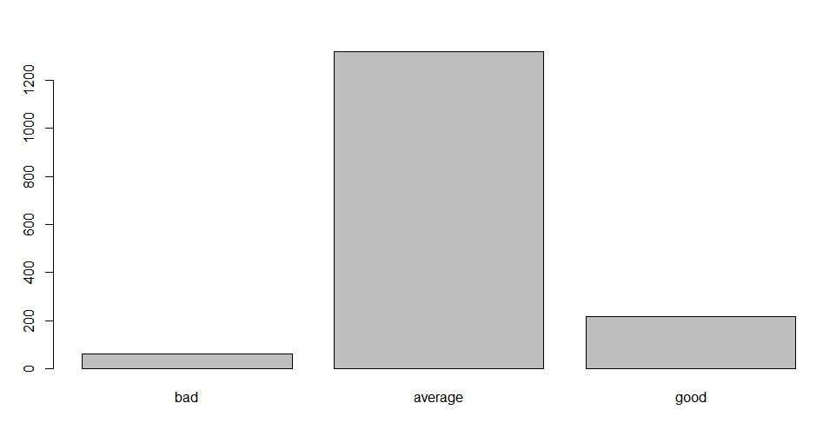
Classification of the wine dataset based on the quality
Quality ranges from 1 to 8
Thus, we classified the data into three categories based on the quality which are good, bad and average.
The wines with quality lesser than 5 are classified as bad, lesser than 7 but greater than 5 are classified as average and quality 8 is classified as a good wine.
We have created a bar plot to observe the number of good, bad and average quality of wines.
We can observe that average quality of wines is significantly more than the good and the bad ones.

Slide 11
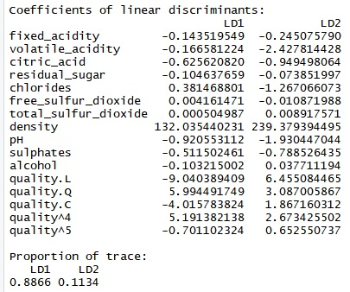
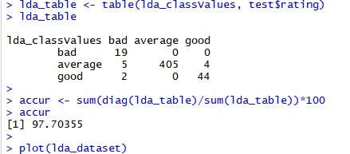
Linear Discriminant Analysis
Linear Discriminant Analysis is used to classify individual objects into two or more groups on the basis of measurements.
We built a model on our Training dataset to classify the quality of wine as bad, average and good.
Considering our comparatively small dataset we got a higher accuracy as we predicted using the test dataset.
The accuracy of predicting the quality of wine if new data is added 97.70355%.

Slide 12
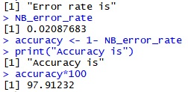

Naïve Bayes
Naive Bayes is a simple technique for constructing classifiers: models that assign class labels to problem instances, represented as vectors of feature values, where the class labels are drawn from some finite set.
According to our analysis, the error rate for Naïve Bayes is 0.02087% and accuracy rate is 97.91232%.
An advantage of Naive Bayes is that it only requires a small number of training data to estimate the parameters necessary for classification.
We can also see the confusion matrix.

Slide 13
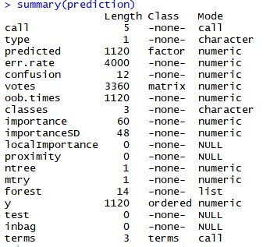
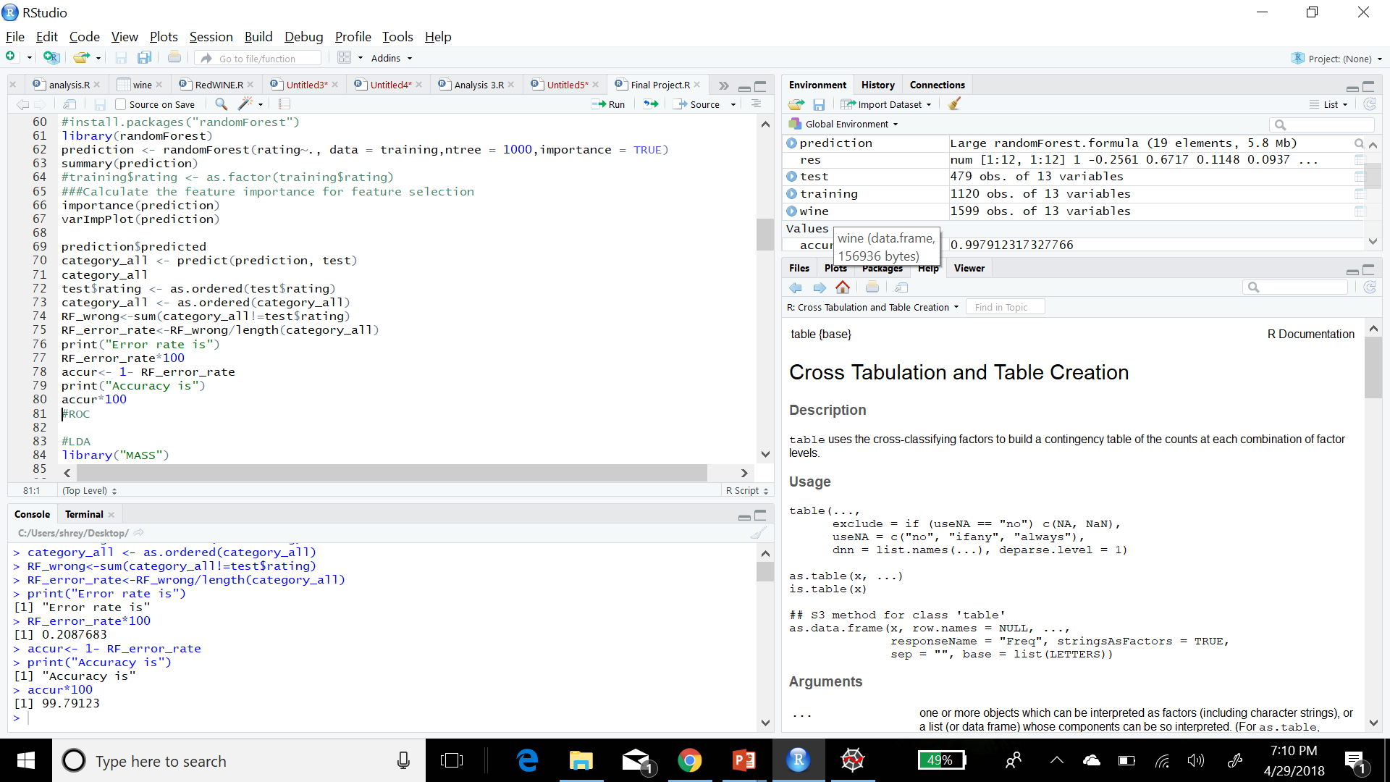
Random Forest
Random forests or random decision forests are an ensemble learning method for classification, regression, and other tasks, that operate by constructing a multitude of decision trees at training time and outputting the class that is the mode of the classes (classification) or mean prediction (regression) of the individual trees.
Accuracy = 99.79 %
So far Random Forest is the best model for prediction of wine quality depending on the factors.

Slide 14
Conclusion
We performed several different analysis to predict the quality of wine if a new dataset is added using different classification models.
After classifying our Dataset based on the quality we observed that majority of the wines fall in the average category.
Based on our observations we could observe that Alcohol and citric acid are directly proportional to the wine quality, whereas factors like Volatile acidity and Chlorides are inversely proportional.
To which we can conclude that comparatively increasing the alcohol and citric acid content in the wine can give us a better quality of the wine. Also, this works inversely for the factors like Volatile acidity and Chlorides.
After comparing different classifiers to predict the accuracy if a new data is added, we could conclude that Random Forest works best for predicting the wine quality based on our dataset.

Slide 15
References
https://www.kaggle.com/
http://www.rdatamining.com/docs/regression-and-classification-with-r

Slide 16


